Slide 1

INSTITUTE - UIE
DEPARTMENT- ACADEMIC UNIT-2
Bachelor of Engineering (Computer Science & Engineering)
Subject Name: Object Oriented Programming using C++
Code:20CST151
Unit-3
Topic: File handling
DISCOVER . LEARN . EMPOWER

Slide 2


Object Oriented Programming using C++
Course Objectives
To enable the students to understand various stages and constructs of C++ programming language and relate them to engineering programming problems.
To improve their ability to analyze and address variety of problems in programming domains.

Slide 3



Course Outcomes
CO Number | Title | Level
CO1 | Provide the environment that allows students to understand object-oriented programming Concepts. | Understand
CO2 | Demonstrate basic experimental skills for differentiating between object-oriented and procedural programming paradigms and the advantages of object-oriented programs. | Remember
CO3 | Demonstrate their coding skill on complex programming concepts and use it for generating solutions for engineering and mathematical problems. | Understand
CO4 | Develop skills to understand the application of classes, objects, constructors, destructors, inheritance, operator overloading and polymorphism, pointers, virtual functions, exception handling, file operations and handling. | Understand

Slide 4
Scheme of Evaluation
Sr. No. | Type of Assessment Task | Weightage of actual conduct | Frequency of Task | Final Weightage in Internal Assessment (Prorated Marks) | Remarks
1. | Assignment* | 10 marks of each assignment | One Per Unit | 10 marks | As applicable to course types depicted above.
2. | Time Bound Surprise Test | 12 marks for each test | One per Unit | 4 marks | As applicable to course types depicted above.
3. | Quiz | 4 marks of each quiz | 2 per Unit | 4marks | As applicable to course types depicted above.
4. | Mid-Semester Test** | 20 marks for one MST. | 2 per semester | 20 marks | As applicable to course types depicted above.
5. | Presentation*** |  |  | Non Graded: Engagement Task | Only for Self Study MNGCourses.
6. | Homework | NA | One per lecture topic (of 2 questions) | Non-Graded: Engagement Task | As applicable to course types depicted above.
7. | Discussion Forum | NA | One per Chapter | Non Graded: Engagement Task | As applicable to course types depicted above.
8. | Attendance and Engagement Score on BB | NA | NA | 2 marks

Slide 5
CONTENTS
Introduction of file handling
File operations and file modes
Examples
Notes:
Computer in the diagram is 3rd generation computer. The period of third generation was from 1965-1971. The computers of third generation used Integrated Circuits (ICs) in place of transistors. A single IC has many transistors, resistors, and capacitors along with the associated circuitry. The main features of third generation are −
IC used
More reliable in comparison to previous two generations
Smaller size
Generated less heat
Faster
Lesser maintenance
Costly
AC required
Consumed lesser electricity
Supported high-level language

Slide 6
What is a File?
A file is a collection of bytes stored on a secondary storage device, which is generally a disk of some kind.
The collection of bytes may be interpreted, for example,
characters, words, lines, paragraphs from a text document;
fields and records belonging to a database;
Or pixels from a graphical image.
We use files to store data which can be processed by our programs.
Not only data but our programs are also stored in files

Slide 7
NEED FOR DATA FILES
Many real life problems requires handling of large amount of data.
Earlier we used arrays to store bulk data.
The problem with the arrays is that arrays are stored in RAM.
The data stored in arrays is retained as long as the program is running. Once the program is over the data stored in the arrays is also lost.
To store the data permanently we need files.
Note: Files are required to save our data (on a secondary storage device) for future use, as RAM is not able to hold our data permanently.

Slide 8
INPUT/OUTPUT IN C++ STREAMS
The input/output system of C++ handles file I/O operations in the same way it handles console I/O operations.
It uses file stream as an interface between programs and files.
A stream is defined as the flow of data.
Different kinds of stream are used to represent different kinds of data flow.
Output stream: The stream which controls the flow of data from the program to file is called output stream.
Input stream: The stream which controls the flow of data from the file to the program is called input stream.

Slide 9
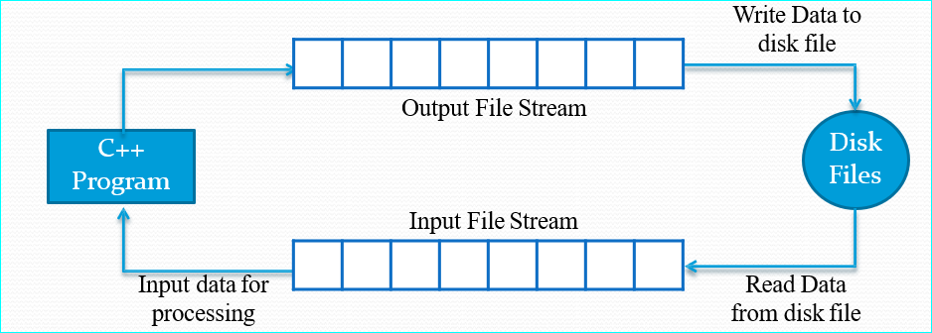
INPUT/OUTPUT IN C++ STREAMS

Slide 10
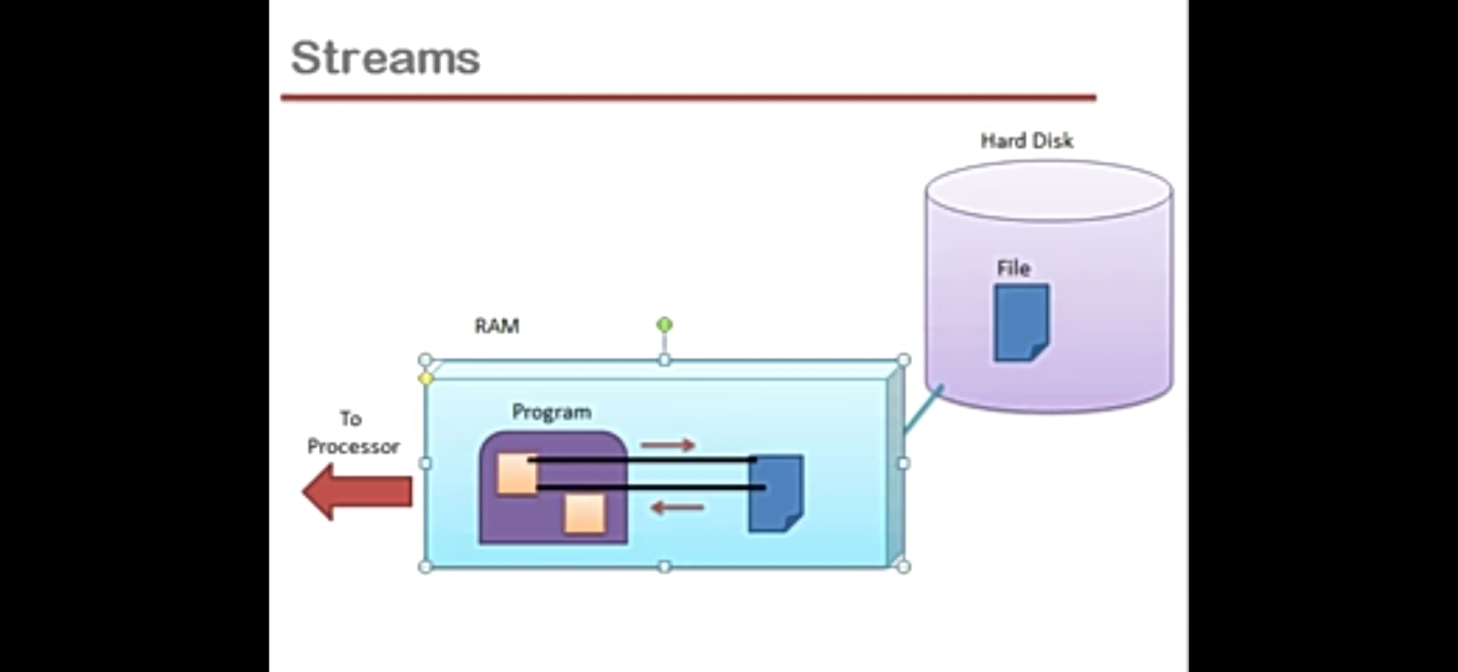

Slide 11
INPUT/OUTPUT IN C++ STREAMS
Each stream is associated with a particular class which contains definitions and methods for dealing with that particular kind of data
These include fstream, ifstream and ofstream. These classes are defined in the header file fstream.h. Therefore it is necessary to include this header file while writing file programs.
The classes contained in fstream.h are derived from iostream.h. Thus it is not necessary to include iostream.h in our program, if we are using the header file fstream.h in it.

Slide 12
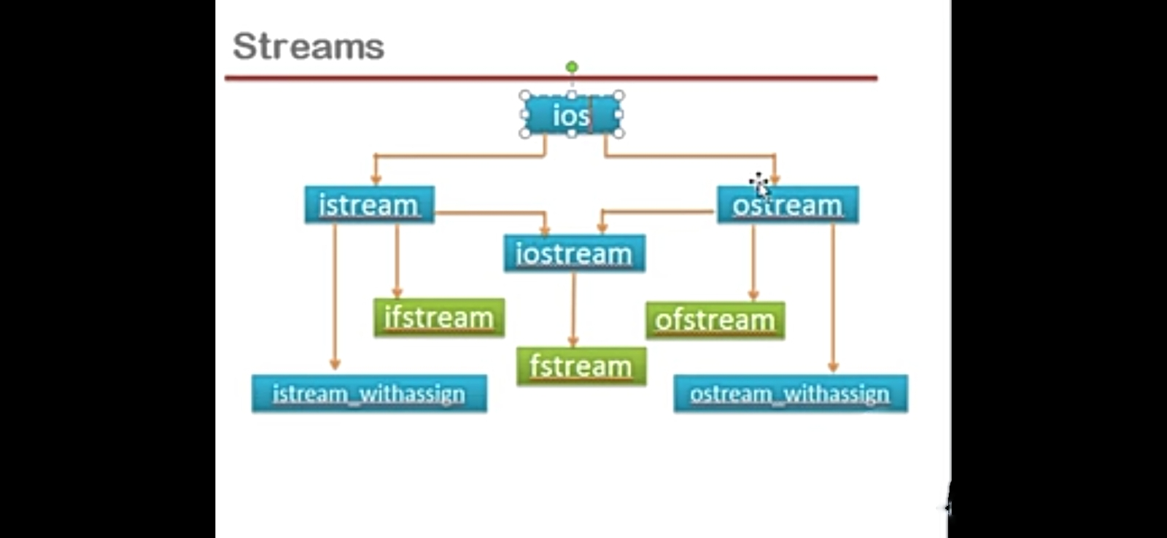

Slide 13
INPUT/OUTPUT IN C++ STREAMS CONTD…
The ifstream class contains open() function with default input mode and inherits the functions get(), getline(), read(), seekg() and tellg().
The ofstream class contains open() function with default output mode and inherits functions put(), write(), seekp() and tellp() from ostream.
The fstream class contains open() function with default input/output mode and inherits all I/O functions from iostream.h.

Slide 14
TYPES OF DATA FILES
There are two types of data files in C++: Text files and Binary files
Text files store the information in ASCII characters. Each line of text in text files is terminated by a special character called EOL. In text files some internal translations take place while storing data.
Binary files store information in binary format. There is no EOL character in binary files and no character translation takes place in binary files.

Slide 15
C++ provides us with the following operations in File Handling:
Creating a file: open()
Reading data: read()
Writing new data: write()
Closing a file: close()

Slide 16
OPENING A FILE
Generally, the first operation performed on an object of one of these classes is to associate it to a real file. This procedure is known to open a file.
We can open a file using any one of the following methods:
1. First is by passing the file name in constructor at the time of object creation.
2. Second is using the open() function.
To open a file, use open() function
Syntax
void open(const char* file_name,ios::openmode mode);
Here, the first argument of the open function defines the name and format of the file with the address of the file.
The second argument represents the mode in which the file has to be opened.

Slide 17
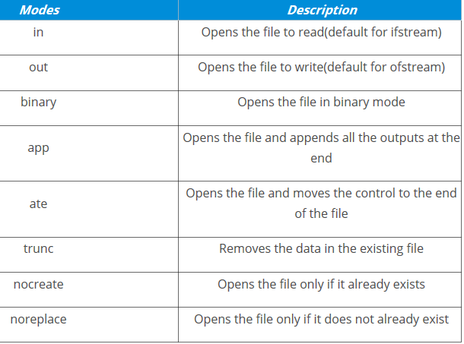
OPENING A FILE- OPENING MODES
The following modes are used as per the requirements
Example:
fstream new_file;
new_file.open(“newfile.txt”, ios::out);
Default Open Modes :
ifstream ios::in
ofstream ios::out
fstream ios::in | ios::out
We can combine the different modes using or symbol | .

Slide 18
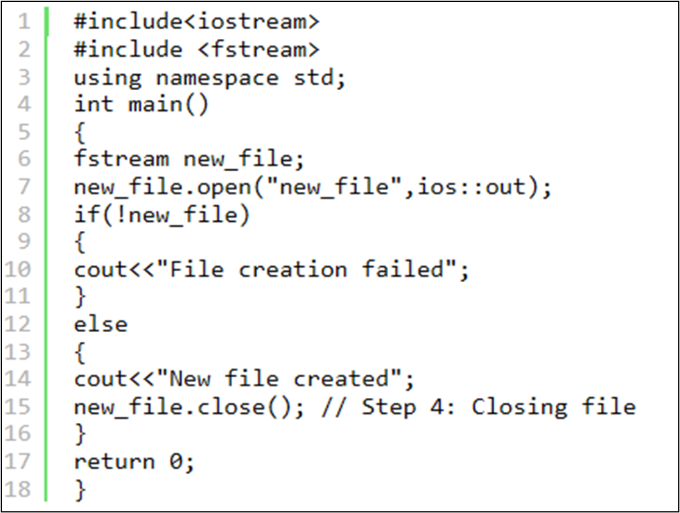
Example of opening/creating a file using the open() function

Slide 19
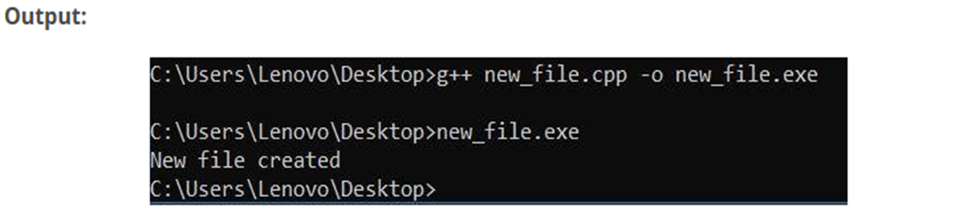
Example of opening/creating a file using the open() function

Slide 20
Program Explanation
In the above example we first create an object to class fstream and name it ‘new_file’.
Then we apply the open() function on our ‘new_file’ object.
We give the name ‘new_file’ to the new file we wish to create and we set the mode to ‘out’ which allows us to write in our file.
We use a ‘if’ statement to find if the file already exists or not if it does exist then it will going to print “File creation failed” or it will create a new file and print “New file created”.

Slide 21
Example 2: opening/creating a file using the open() function
#include <iostream>
#include <fstream>
using namespace std;
int main() {
fstream my_file;
my_file.open("my_file", ios::out);
if (!my_file) {
cout << "File not created!";
}
else {
cout << "File created successfully!";
my_file.close();
}
return 0;}

Slide 22
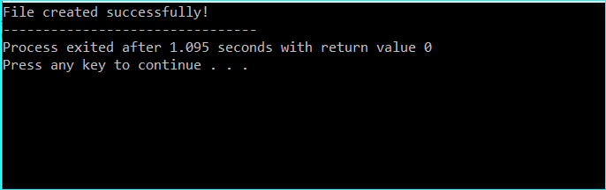
Output

Slide 23
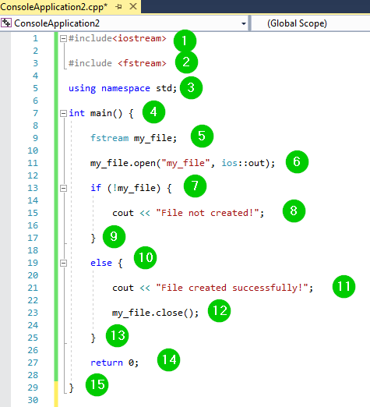
Screenshot of the code:

Slide 24
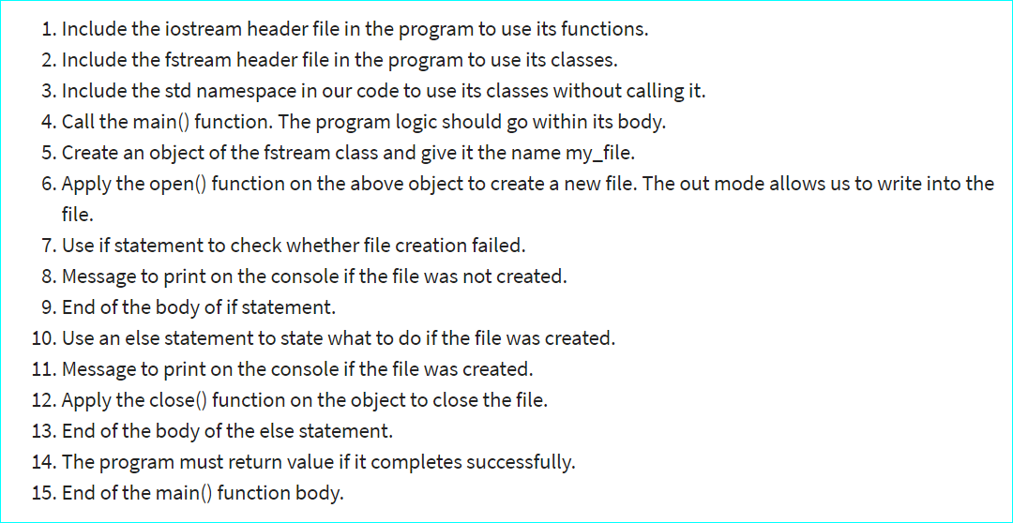
Explanation of the Program

Slide 25
Close a File
It is simply done with the help of close() function.
Syntax: File Pointer.close()

Slide 26
Close a File
#include <iostream>
#include <fstream>
using namespace std;
int main()
{
fstream new_file;
new_file.open("new_file.txt",ios::out);
new_file.close();
return 0;
}
Output:
The file gets closed.

Slide 27
Applications
Files are used to store data in a storage device permanently. File handling provides a mechanism to store the output of a program in a file and to perform various operations on it.
Reusability: It helps in preserving the data or information generated after running the program.
Large storage capacity: Using files, you need not worry about the problem of storing data in bulk.

Slide 28
Summary
In this lecture we have discussed about File Handling.
We have discussed about File Operations and File modes
Discussed about examples of Opening and Closing a file

Slide 29
Frequently Asked question
Q1:It is not possible to combine two or more file opening mode in open () method.
A. TRUE
B. FALSE
C. May Be
D. Can't Say
Ans: B

Slide 30
Q2: Which of the following methods can be used to open a file in file handling?
A. Using Open ( ) B. Constructor method C. Destructor method D. Both A and B
Ans: D

Slide 31
Q3: Which is correct syntax ?
A. myfile:open ("example.bin", ios::out);
B. myfile.open ("example.bin", ios::out);
C. myfile::open ("example.bin", ios::out);
D. myfile.open ("example.bin", ios:out);
Ans: B

Slide 32
Assessment Questions:
1. ios::trunc is used for ?
A. If the file is opened for output operations and it already existed, no action is taken.
B. If the file is opened for output operations and it already existed, then a new copy is created.
C. If the file is opened for output operations and it already existed, its previous content is deleted and replaced by the new one.
D. None of the above
2. Which of the following true about FILE *fp
A. FILE is a structure and fp is a pointer to the structure of FILE type
B. FILE is a buffered stream
C. FILE is a keyword in C for representing files and fp is a variable of FILE type
D. FILE is a stream

Slide 33
3 . Which of the following is used to create an output stream?
a) ofstream
b) ifstream
c) iostream
d) fsstream
4. Which header file is required to use file I/O operations?
a) <ifstream>
b) <ostream>
c) <fstream>
d) <iostream>
5. Which of the following is not used as a file opening mode?
a) ios::trunc
b) ios::binary
c) ios::in
d) ios::ate

Slide 34
Discussion forum.
TRY THIS!!
Given that a binary file “student.dat” is already loaded in the memory of the computer with the record of 100 students, the task is to read the Kth record and perform some operations.

Slide 35

REFERENCES
Reference Books
[1] Programming in C by Reema Thareja.
[2] Programming in ANSI C by E. Balaguruswamy, Tata McGraw Hill.
[3] Programming with C (Schaum's Outline Series) by Byron Gottfried Jitender Chhabra, Tata McGraw Hill.
[4] The C Programming Language by Brian W. Kernighan, Dennis Ritchie, Pearson education.
Websites:
https://www.tutorialspoint.com/cplusplus/cpp_files_streams.htm
https://www.edureka.co/blog/file-handling-in-cpp/
https://www.geeksforgeeks.org/file-handling-c-classes/
YouTube Links:
What is File Handling?
https://spoken-tutorial.org/watch/C+and+Cpp/File+Handling+In+C/English/

Slide 36
THANK YOU

